Slide 1
Using Web Services in C++
Steve Gates, Microsoft
stgates@microsoft.com

Slide 2
Overview
What a typical web service looks like
Some options for consuming
Share a library, the C++ Rest SDK, we’ve been building
Walkthrough how to use
How you can get involved if interested
We’ll be looking at code
Snippets on slides
In IDE
Cursory knowledge of HTTP, JSON, REST, and some other standards and protocols assumed

Slide 3
What exactly is a web service?

Slide 4
Or a network service?

Slide 5
Remote Procedure Call
RFC 707 – “High-level framework for network-based resource sharing”
At its simplest, the ability to run a function on another machine and get the result
A server offers a set of callable operations to clients
Using familiar local procedure calls, hides away
Parameters, message format
Transmission protocol details

Slide 6
What is a web service?
WC3 – “A Web service is a software system designed to support interoperable machine-to-machine interaction over a network.”
In general I think of a ‘web service’ as a method of communication between two computers over the world wide web
Two popular variants are SOAP and REST
Term ‘web service’ is somewhat intertwined with SOAP
This talk will mainly focus on REST style services, or web APIs delivered over HTTP

Slide 7
REpresentational State Transfer
Architectural style for designing a distributed system
A service is RESTful if conforms to the following set of constraints:
Client-server separation
Stateless
Uniform interface
Cacheable
Layered system
Code on demand (optional)
For a web services this means
Interact with resources using URIs
Interface using HTTP methods
No specific data format, but often JSON

Slide 8
OK what are some real examples…

Slide 9
Popular web services/web APIs
Service | Protocols/Standards
Google Maps | HTTP, URI, XML, JSON
Facebook Graph API | HTTP, URI, OAuth, JSON
Twitter | HTTP, URI, OAuth, JSON
Amazon S3 | HTTP, URI, XML
Azure Storage | HTTP, URI, XML, JSON (tables)
Dropbox | HTTP, URI, OAuth, JSON
WordPress | HTTP, URI, OAuth, JSON
Common protocols and standards – HTTP, URI, JSON, OAuth

Slide 10
Popular web services/web APIs
Those are just a handful of web APIs, there are tons look at
http://www.programmableweb.com/
http://www.mashape.com/

Slide 11
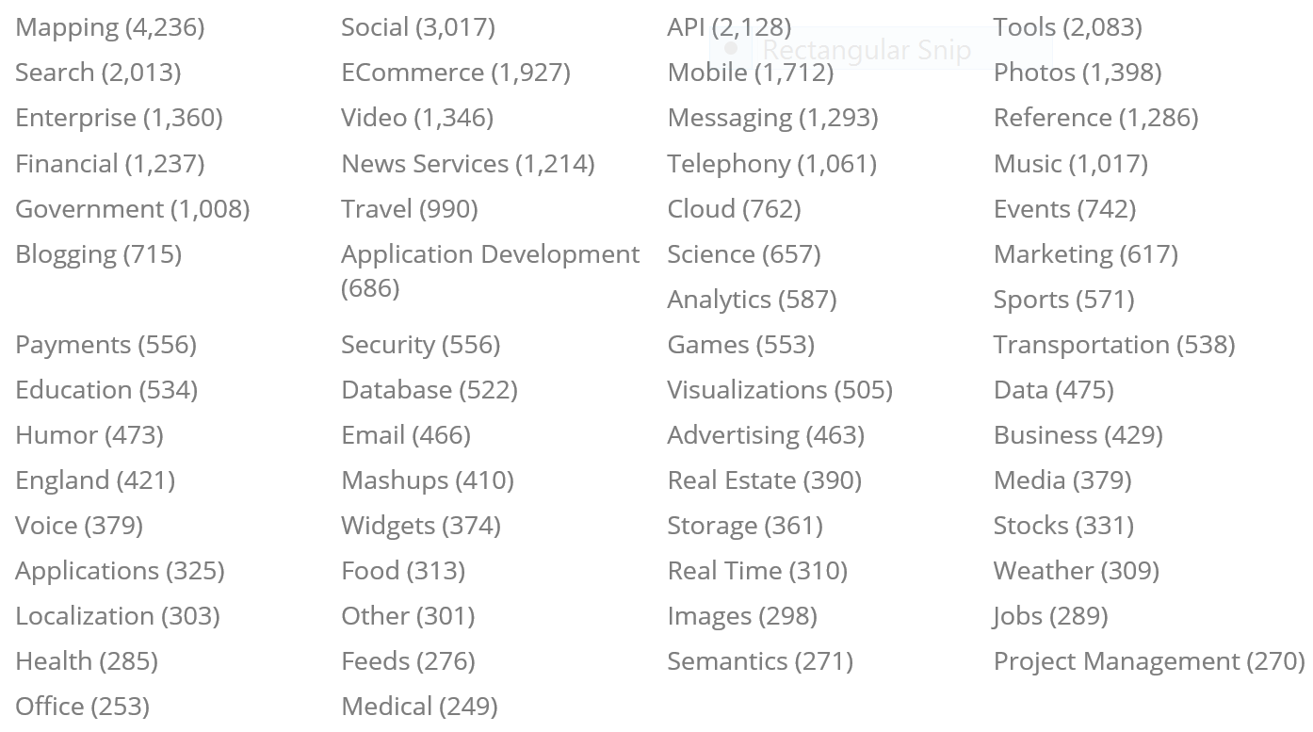
Popular web services/web APIs
Just first page of categories on ProgrammableWeb

Slide 12
How can I use these web APIs now?

Slide 13
Available options
Some services have dedicated client side SDKs (probably not in C++)
Write directly to the exposed HTTP endpoints
Most languages (other than C++) have good library support
What about C++?
Use existing HTTP library
Could use platform specific HTTP APIs when available
Write HTTP on top of TCP socket library
What about if you care about asynchrony, cross platform, and C++11 style?

Slide 14
The C++ Rest SDK
The C++ Rest SDK aims to fill these gaps by providing the building blocks for accessing services with high level APIs covering:
HTTP, URIs, JSON, OAuth, and WebSockets
Approach is not to re-write everything, re-use what is appropriate
Reuse existing open source libraries
Build on platform APIs
Goal is to make it easier to consume web APIs and write client SDK libraries

Slide 15
The C++ Rest SDK
Simple APIs
Having every single feature is not as important as a straight forward API
Asynchronous
All I/O and potentially long running work needs to be asynchronous
C++11 style
All the code I show you the today runs on Windows desktop/server (XP+), Windows Store, Windows Phone, OS X, iOS, Ubuntu, and Android

Slide 16
Asynchrony pplx::task

Slide 17
pplx::task
Cross platform tasks from Parallel Patterns Library (PPL)
Similar to std::future, but with continuations
Later could be replaced with futures (N3970)
Lots of existing presentations and resources on task based programming
task APIs
scheduler interface
Windows Threadpool ConcRT
Boost ASIO pthreads
Grand Central Dispatch
Notes:
Not going to talk much about how to construct and launch tasks, just covering enough to under using and consuming in the C++ Rest SDK.

Slide 18
pplx::task – continuations
pplx::task<int> intTask = start_op();
intTask.then([](int value)
{
// Execute some work once operation has completed...
});
Can also compose tasks using pplx::when_any and pplx::when_all constructs

Slide 19
pplx::task – exception handling
pplx::task<int> intTask = pplx::create_task([]() -> int
{ throw std::runtime_error("error"); });
intTask.then([](pplx::task<int> op)
{
try
{
int value = op.get();
} catch (const std::runtime_error &e)
{ /* Perform error handling... */ }
});
Task based continuation, always executes

Slide 20
http_client

Slide 21
http_client
http_client request/response utilities
WinHTTP
IXHR2
(WinRT)
Boost ASIO
OpenSSL
Support for HTTP/1.1 – client initiated request/response protocol
Simple high level API for managing HTTP requests
No dealing with individual connection management

Slide 22
http_client – hello world upload
http_client client(U("http://myserver.com"));
http_response response = client.request(methods::POST, U("mypath"), U("Hello World")).get();
if (response.status_code() == status_codes::OK)
{
// Inspect response...
}
What is the ‘U’? Platform dependent string type, to allow using preferred type:
On Windows UTF-16, std::wstring
Other platforms UTF-8, std::string

Slide 23
http_client – hello world upload
// Manually build up request.
http_request req(methods::POST);
req.set_request_uri(U("mypath"));
req.headers().add(header_names::user_agent, U(“myclient"));
req.set_body(U("Hello World"));
http_response response = client.request(req).get();
http_client also takes configuration for options like timeouts, chunk size, etc…

Slide 24
http_client – hello world download
http_client client(U("http://myserver.com"));
http_response response = client.request(methods::GET).get();
if (response.status_code() == status_codes::OK)
{
const utility::string_t body = response.extract_string().get();
}
http_response contains functionality for getting body as string, JSON, vector, or a stream

Slide 25
http_client – hello world, better
http_client client(U("http://myserver.com"));
client.request(methods::GET).then([](http_response response)
{
// Check status code...
return response.extract_string();
}).then([](const utility::string_t &body)
{
// Use string...
});

Slide 26
http_client – request/response flow
http_client client(U("http://myserver.com"));
pplx::task<http_response> pendingRequest = client.request(methods::GET);
pendingRequest.then([](http_response response)
{
pplx::task<utility::string_t> extractString = response.extract_string();
return extractString;
})
.then([](const utility::string_t &body)
{
// Use string...
});
Entire request sent, response headers arrived
Entire response arrived
Notes:
Talk about how exception handling works here.

Slide 27
It’s not that I don’t believe you, but I need to see it

Slide 28
Yoda Speak

Slide 29
http_client – efficient streaming
http_client client(U("http://myserver.com"));
// Create stream backed by a vector.
http_request request(methods::GET);
container_buffer<std::vector<uint8_t>> buffer;
buffer.collection().reserve(1024 * 1024 * 4);
request.set_response_stream(buffer.create_ostream());
// Send request and wait for response to arrive.
http_response response = client.request(request).get();
response.content_ready().wait();
std::vector<uint8_t> body = std::move(buffer.collection());
Heap allocation all at once up front
Important to move!

Slide 30
http_client – efficient streaming
// Buffer backed by a file.
streambuf<uint8_t> buffer = file_buffer<uint8_t>::open(U("myfile")).get();
// Buffer backed by raw memory.
const size_t size = 1024 * 1024 * 4;
char * raw = new char[size];
rawptr_buffer<uint8_t> buffer(reinterpret_cast<uint8_t *>(raw), size);

Slide 31
http_client – efficient streaming
Buffer backed with contiguous storage can allow for further optimization on some platforms
Tuning chunk size for message bodies – saves traversing up and down the stack
Acquire pointer to internal storage
Sending request body –pass directly into platform API for reading
Receiving response body –pass directly into platform API for writing

Slide 32
Dropbox Upload

Slide 33
websocket_client

Slide 34
websocket_client
Enables bi-directional communication over a persistent TCP socket after an HTTP request
In contrast with the HTTP request/response model, servers can push messages
Domains – frequent small messaging, gaming, interactive collaborative applications
websocket_client, messages, utilities
Message WebSocket (WinRT)
WebSocket++ Boost ASIO OpenSSL

Slide 35
websocket_client – opening connection
websocket_client client;
client.connect(U("ws://myserver.com")).then([]
{
// Connection successfully opened...
});
// Later on when done...
client.close().then([]
{
// Connection is closed...
});
websocket_client also takes configuration for options like HTTP upgrade request headers and subprotocols

Slide 36
websocket_client – sending
// Strings
websocket_outgoing_message msg;
msg.set_utf8_message("Hello World");
pplx::task<void> sendTask = client.send(msg);
// Binary
websocket_outgoing_message msg;
streambuf<uint8_t> buffer = file_buffer<uint8_t>::open(U("myfile")).get();
msg.set_binary_message(buffer.create_istream(), 10); // Send only 10 bytes
pplx::task<void> sendTask = client.send(msg);

Slide 37
websocket_client – receiving
websocket_client client;
client.receive().then([](websocket_incoming_message msg)
{
return msg.extract_string(); // Msg body could still be arriving
}).then([](std::string &data)
{
// Use string...
});
Can also access body as a stream
Adding option for using callback for repeated message receiving

Slide 38
Cross platform learning
Test automation infrastructure
Gated, rolling, nightly
Make test cases cross platform by default
Be careful about build system complexity
Think of platforms as ‘features’
Sometimes have to write mini-shims to hide missing libraries
Even when not fully using cross platform capabilities, users like the option
Layer APIs to allow dropping down if necessary

Slide 39
C++ Rest SDK
For more details the library can be located on CodePlex:
http://casablanca.codeplex.com/
Release as open source under Apache 2.0 license
We accept contributions, let me know if interested

Slide 40
Questions?

